Slide 1
Strings and Pattern Matching

Slide 2
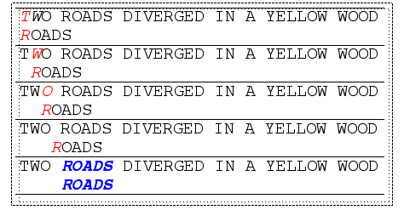
Brute Force
The Brute Force algorithm compares the pattern to the text, one character at a time, until unmatching characters are found
  Compared characters are italicized.
  Correct matches are in boldface type.
The algorithm can be designed to stop on either the first occurrence of the pattern, or upon reaching the end of the text.

Slide 3
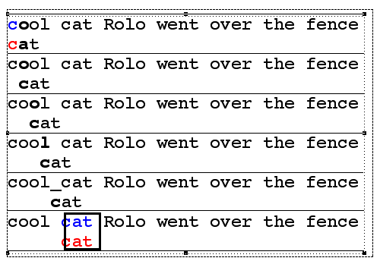
Brute Force Pseudo-Code
Here’s the pseudo-code
do if (text letter == pattern letter)
compare next letter of pattern to next
letter of text
else move pattern down text by one letter
while (entire pattern found or end of text)

Slide 4
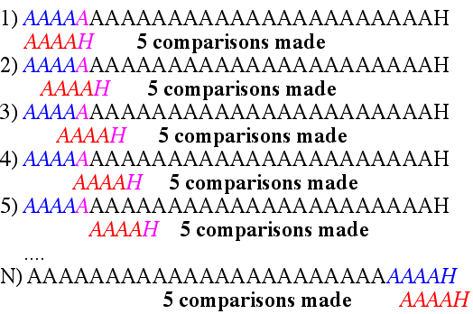
Brute Force-Complexity
Given a pattern M characters in length, and a text N characters in length...
Worst case: compares pattern to each substring of text of length M. For example, M=5.
This kind of case can occur for image data.
Total number of comparisons: M (N-M+1)
Worst case time complexity: O(MN)

Slide 5

Brute Force-Complexity(cont.)
Given a pattern M characters in length, and a text N characters in length...
Best case if pattern found: Finds pattern in first M positions of text. For example, M=5.
Total number of comparisons: M
Best case time complexity: O(M)

Slide 6
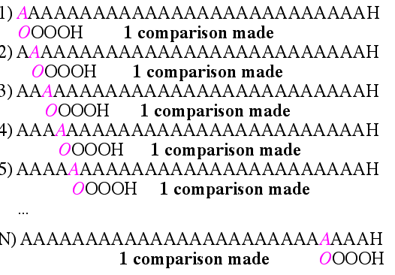
Brute Force-Complexity(cont.)
Given a pattern M characters in length, and a text N characters in length...
Best case if pattern not found: Always mismatch on first character. For example, M=5.
Total number of comparisons: N
Best case time complexity: O(N)

Slide 7
Rabin-Karp
The Rabin-Karp string searching algorithm calculates a hash value for the pattern, and for each M-character subsequence of text to be compared.
If the hash values are unequal, the algorithm will calculate the hash value for next M-character sequence.
If the hash values are equal, the algorithm will do a Brute Force comparison between the pattern and the M-character sequence.
In this way, there is only one comparison per text subsequence, and Brute Force is only needed when hash values match.

Slide 8
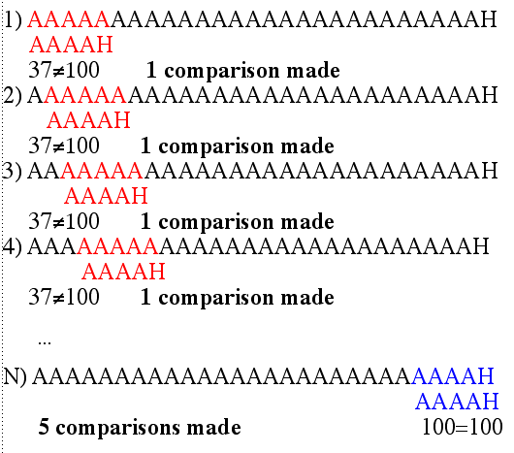
Rabin-Karp Example
Hash value of “AAAAA” is 37
Hash value of “AAAAH” is 100

Slide 9
Rabin-Karp Algorithm
pattern is M characters long
hash_p=hash value of pattern
hash_t=hash value of first M letters in body of text
do
if (hash_p == hash_t)
brute force comparison of pattern and selected section of text
hash_t= hash value of next section of text, one character over
while (end of text)

Slide 10
Rabin-Karp
Common Rabin-Karp questions:
“What is the hash function used to calculate values for character sequences?”
“Isn’t it time consuming to hash very one of the M-character sequences in the text body?”
To answer some of these questions, we’ll have to get mathematical.

Slide 11

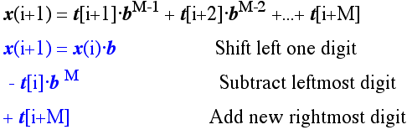
Hash Function
Let b be the number of letters in the alphabet. The text subsequence t[i .. i+M-1] is mapped to the number
Furthermore, given x(i) we can compute x(i+1) for the next subsequence t[i+1 .. i+M] in constant time, as follows:
In this way, we never explicitly compute a new value. We
simply adjust the existing value as we move over one
character.

Slide 12
Rabin-Karp Math Example
Let’s say that our alphabet consists of 10 letters.
our alphabet = a, b, c, d, e, f, g, h, i, j
Let’s say that “a” corresponds to 1, “b” corresponds to 2 and so on.
The hash value for string “cah” would be ...
3*100 + 1*10 + 8*1 = 318

Slide 13
Rabin-Karp Mods
If M is large, then the resulting value (~b^{M}) will be enormous. For this reason, we hash the value by taking it mod a prime number q.
The mod function is particularly useful in this case due to several of its inherent properties:
[(x mod q) + (y mod q)] mod q = (x+y) mod q
(x mod q) mod q = x mod q
For these reasons:
h(i)=((t[i] b^{M-1} mod q) +(t[i+1] b^{M-2} mod q) + … +(t[i+M-1] mod q))mod q
h(i+1) =( h(i) b mod q
Shift left one digit
-t[i] b^{M} mod q
Subtract leftmost digit
+t[i+M] mod q )
Add new rightmost digit
mod q

Slide 14
Rabin-Karp Complexity
If a sufficiently large prime number is used for the hash function, the hashed values of two different patterns will usually be distinct.
If this is the case, searching takes O(N) time, where N is the number of characters in the larger body of text.
It is always possible to construct a scenario with a worst case complexity of O(MN). This, however, is likely to happen only if the prime number used for hashing is small.

